Slide 1
Titanic Problem
Date: 2021-03-22
Team 5
Devan Moses
Dhruv Patel
David Wolfson
Devesh Kakkar
Hua Zhao
Contents
- Dataset
ML solutions
DEAP solution
EMADE DEAP solution

Slide 2
ML

Slide 3
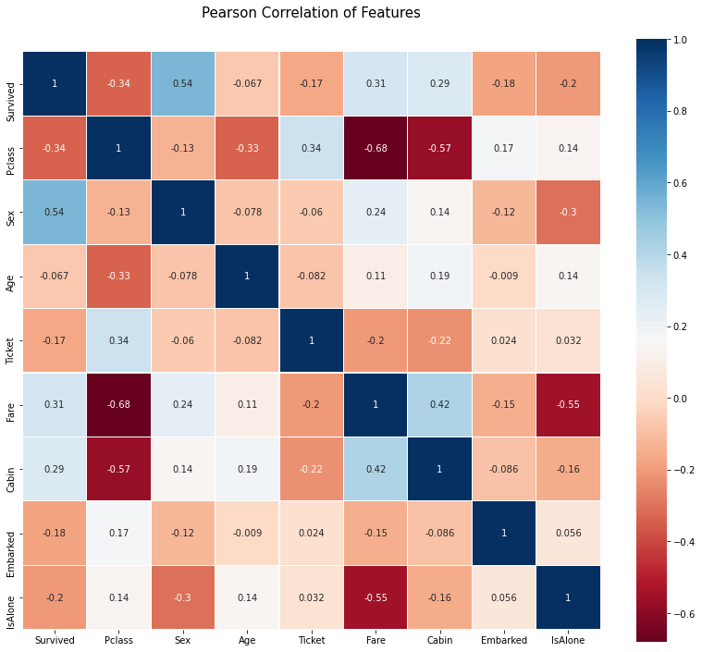
dataset
Feature Selection: (all categorical values)
Pclass
Sex
Age
Ticket
Fare
Cabin
Embarked
IsAlone
 | AgeRange | Survived
0 | (0.34, 16.336] | 0.550000
1 | (16.336, 32.252] | 0.369942
2 | (32.252, 48.168] | 0.404255
3 | (48.168, 64.084] | 0.434783
4 | (64.084, 80.0] | 0.090909

Slide 4
ML Pareto frontier
 | 0.25 test size
 | FPR | FNR | Algorithm
David | 0.0408 | 0.4342 | KNN
Zhao | 0.0612 | 0.4079 | Nerual Network
Dhruv | 0.0680 | 0.3684 | Nerual Network
Devesh | 0.1156 | 0.3553 | K-Nearest Neighbors
Devan | 0.2300 | 0.1600 | Decision Tree

Slide 5
DEAP only

Slide 6
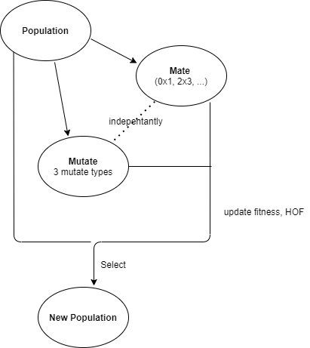
Complete Algorithm
Complete Algorithm
Dataset:
fare, cabin are added into dataset
0~1 normalization for each attribute/feature
Objectives:
Max. (-1*FNR)
Max. (-1*FPR)
Round output closest integer (0, 1).
Primitives: add, subtract, multiply, sin, sigmoid, power of 2, cos
Mutation: mutUniform. mutNodeReplacement, mutShrink
Mate: CxOnePointLeafBiased
Select: selNSGA2
fixed parameters
Numer of child: 100
Number of population: 50
Mate probability: 0.5

Slide 7
Runs
 | GP 1 | GP 2 | ML
Primitives | add, subtract, multiply, sin, sigmoid | +power of 2, +cos | -
Mutations | mutUniform. | +mutNodeReplacement +mutShrink | -
Mutation Prob | 0.10 | +0.05 | -
Generation # | 50 | 1500 | -
Performance: AUC on training | 0.1550 | 0.1125 | -
Performance: AUC on validation | 0.1019 | 0.1305 | 0.2379

Slide 8
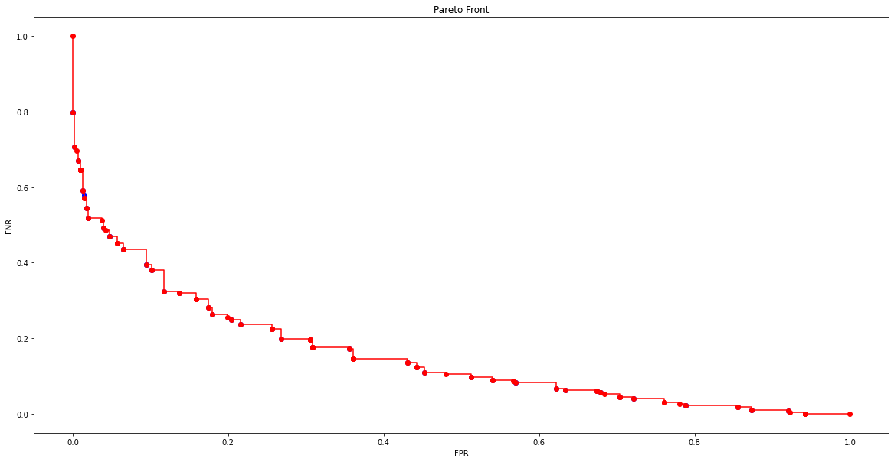
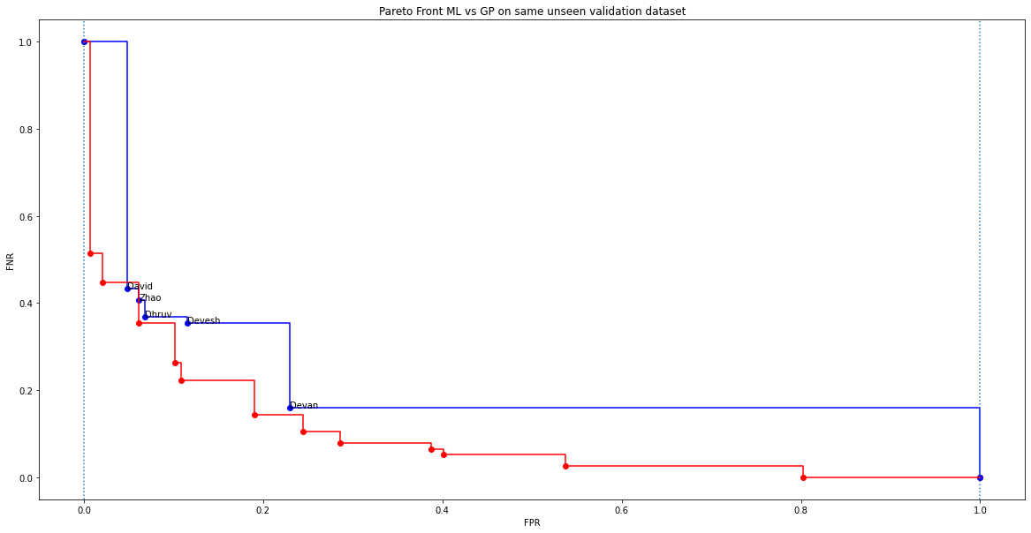
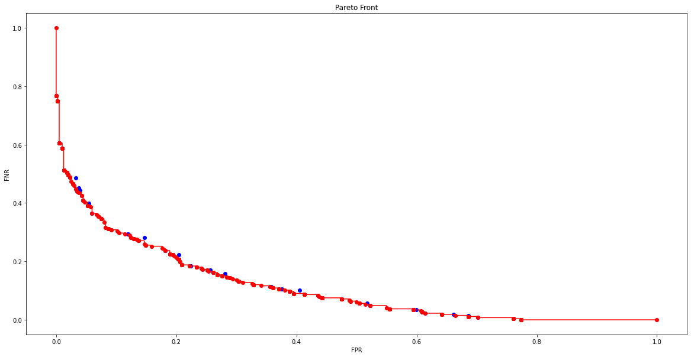
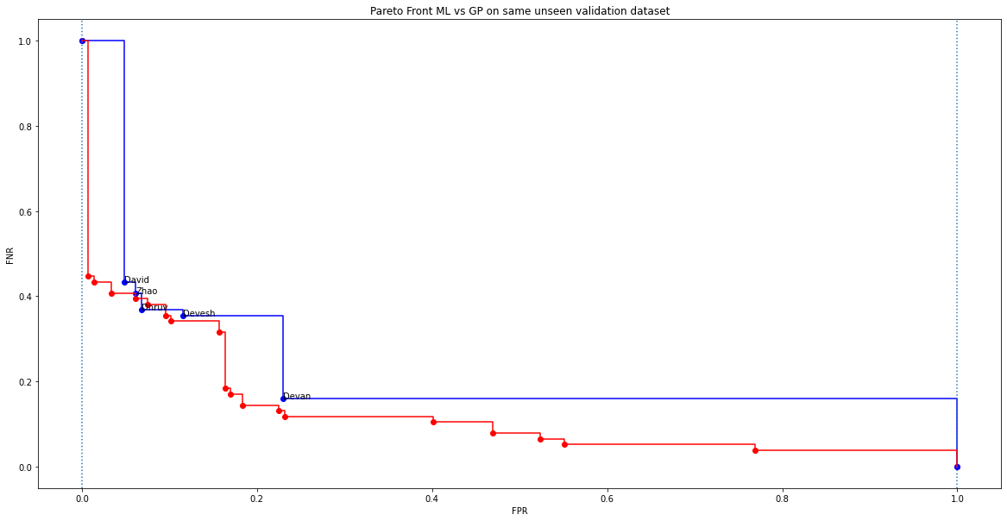
Runs – Continue…
Training AUC
Validation AUC, vs. ML
50 Gen
1500 Gen

Slide 9
EMADE + DEAP

Slide 10
Complete Algorithm
Complete Algorithm
Dataset (modified)
Same as previous
- Objectives: (modified)
Max. (-1*FNR)
Max. (-1*FPR)
Primitives: (default)
Basic: <, <=, >, >=, =, !=, &, |, ~, …….. Etc,.
Advanced: learnertype of svm, random forest, ….etc.
Mutation (default):
insert, insert modify, ephermeral, node replace, uniform, shrink
Mate: (default)
(crossover, .5), (crossoverEphemeral, .5). (headlessChicken, .1), (headlessChickenEphemeral, .1)
Select:
selNSGA2
Population size:
256
HOF size:
256
Work distribution
1 main process + 1 database server + 5 worker processes

Slide 11
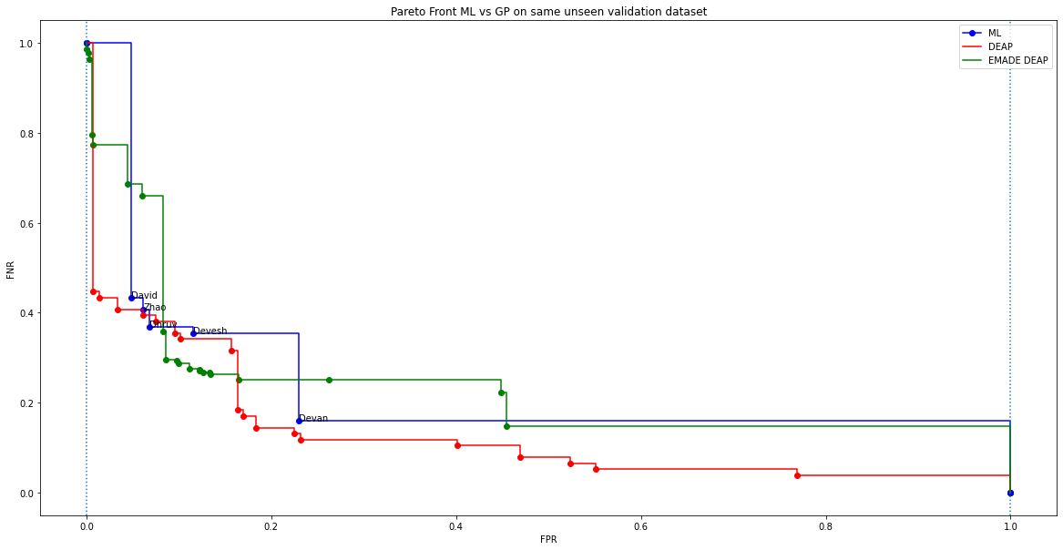
EMADE DEAP vs DEAP vs ML
EMADE
Time take: 4 hours
Generation: 37th
Pareto Frontier AUC
EMADE: 0.2374
GP: 0.1305
ML: 0.2379
Pareto Frontier member #
ML 5
DEAP 45
EMADE 22

